Slide 1
Welcome to 5760
Applied Business Statistics

Slide 2
Me - Robert Wrobel
Education: Philosophy (BA), Economics (BS), Political Science (MA), Political Science - Political Economy / Public Policy (PhD in progress / ABD)
Taught here (and elsewhere) for 10ish years now
Courses taught: Applied Business Statistics, Quantitative Methods, Introductory Statistics, Current Economic Analysis, Managerial Economics, Introductory Economics, Introductory Microeconomics
Programming languages taught / used: Python, R, Stata, Javascript
Other related interests: Electronics, IoT & Microcontrollers (Arduino / Raspberry Pi)
What I do professionally: I am the IT and Marketing manager for a group of car dealerships. I analyze data and use it to make business decisions!

Slide 3
Contacting Me
Email: robertwrobel49@webster.edu
Phone: (314) 825-6315
I prefer texting and am much better at responding to texts.
If you call, text first and let me know you’re a student or I’ll probably ignore the call.
Please keep all phone / text correspondence between 9 AM and 11 PM, unless your goal is to irritate me.
I am happy to meet outside of class and/or do Zoom calls.

Slide 4
Contacting Me with AI
DON’T
I absolutely detest emails, texts, etc. that are generated by AI.
I would much rather read typos, slang, broken english, etc. than another..
“I hope this letter finds you well”

Slide 5
The Class - Applied Business Statistics
Data Visualization
Descriptive Statistics
Sampling
Probability
Hypothesis Testing
Analysis of Variance
Regression
Causal Inference
Time Series Analysis, and…
Python - So you can actually do / apply this stuff in real life / with real data!
Don’t Panic. I will teach you everything you need to know!

Slide 6
Your Grade
25% - Assignment 1 - Data Wrangling with Pandas
25% - Assignment 2 - Linear Regression with Statsmodels
25% - Exam 1 - Descriptive Statistics, Probability, Hypothesis Testing, etc.
25% - Exam 2 - Regression, Time Series Analysis, etc.
?% - Extra Credit - TBD and based on class worthiness
Exam 1 is likely taking place in week 5 and exam 2 in week 9.

Slide 7
How to Succeed
This class is hard for a lot of students, but it really doesn’t have to be.
Pro tips:
Put away your phones and computers (unless needed for the in-class activity)
Don’t talk during the lectures
Pay attention - Don’t just listen, think!
Ask questions any time you don’t understand something
Do the in class practice
Come to each lecture
Use my additional study resources (in the Github repo)
Reach out to me for assistance outside of class*
No student who has done honest* work and asked for my help understanding the material has failed my course and almost everyone who puts in real effort gets an A or B

Slide 8
How to Fail
I am not saying this to scare you or make myself seem mean, tough, etc., but…
I fail a lot of students, roughly a third, and this occurs for two reasons:
Plagiarism on the homework assignments
Cheating on the exams
If you cannot do you own honest work in this course, I beg you to just drop the class now and spare us both the frustration and heartache.
Some of you may be tricky enough to actually successfully cheat, but sooooooo many of those who thought they were that tricky turned out to be not anywhere near as tricky as they thought.
My ears and eyes work perfectly well and I teach data analysis and computing, not to mention I was a student myself and have taught for a decade…I know at least a few things you probably don’t. DON’T RISK IT!!!!

Slide 9
Plagiarism Policy
I have a number of techniques for detecting AI generated homework submissions.
If I catch you with one of them, I will not be allowing you to try again.
It is not fair to me to lose time with my love ones and/or doing things I enjoy so that I can regrade work you should have done honestly the first time.
Don’t ask for another chance. The answer is NO!

Slide 10
Exam Policy
Exams are a SOLO activity
Don’t share your answers
Don’t look at other peoples’ exams
Don’t use outside materials
No phones or electronics of any sort
No non-verbal communication
Don’t use prior copies of exams that have circulated in the past
Do not ask for another chance if you’re caught cheating. The answer is NO!

Slide 11
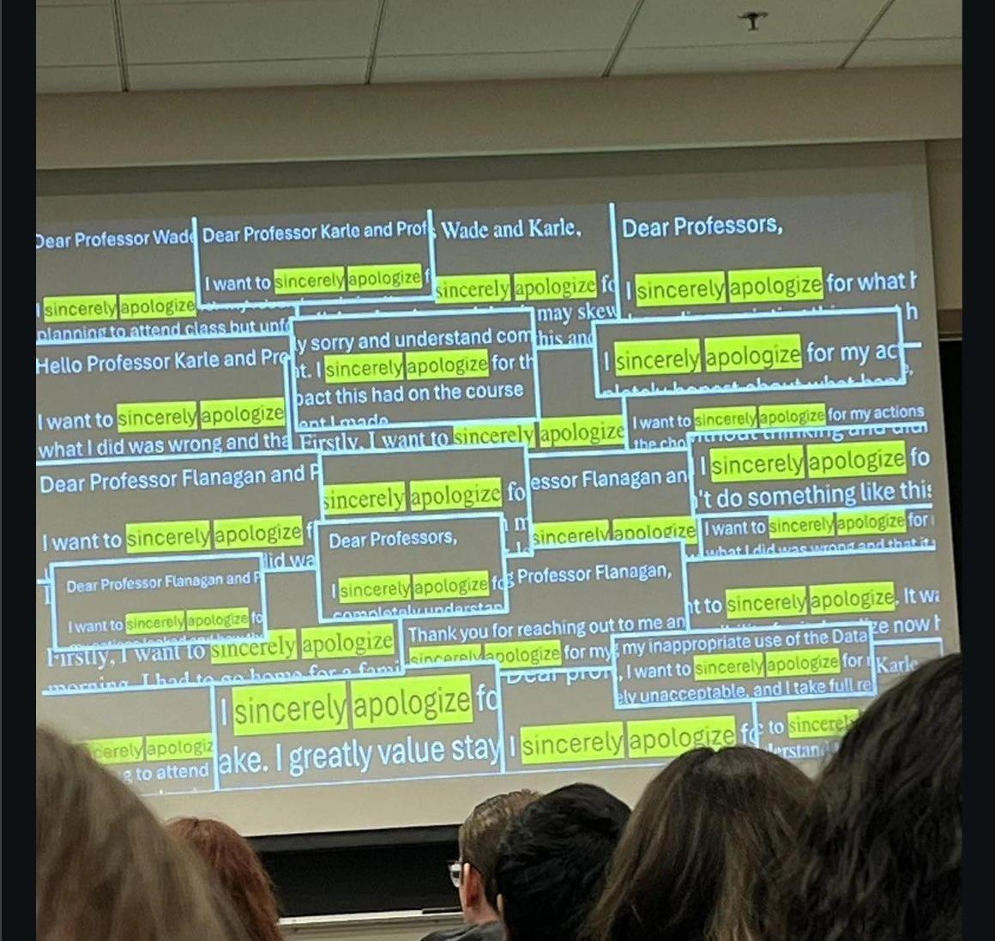
Final Thoughts on Cheating
I don’t want to fail you, but I swear on everything good in the universe that I will and have done so to at least a hundred students at this point.
If you can’t help yourself and expect to violate my rules, do us all a favor and drop the course ASAP.
All that said, I prefer so very much that you all succeed and will go out of my way to ensure that you do, so long as you are honest and do honest work.

Slide 12
What You’ll Be Able To Do After This Course
Take a messy, real-world dataset and turn it into something usable
Explore and visualize data to uncover patterns and problems
Build and interpret regression and classification models
Evaluate whether a model is actually useful (not just “statistically significant”)
Avoid common mistakes that make analyses look good but fail in reality
Use Python to perform real data analysis
Translate results into clear, actionable business decisions
Yay!

Slide 13
Resources
Course Materials via Github - Including study guides, cheat sheets, textbooks, etc.
Download Anaconda (Python)
Crash Course Statistics - Awesome short video lectures
Khan Academy Statistics

